Slide 1


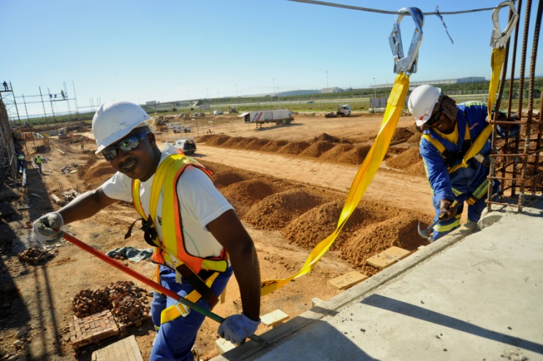
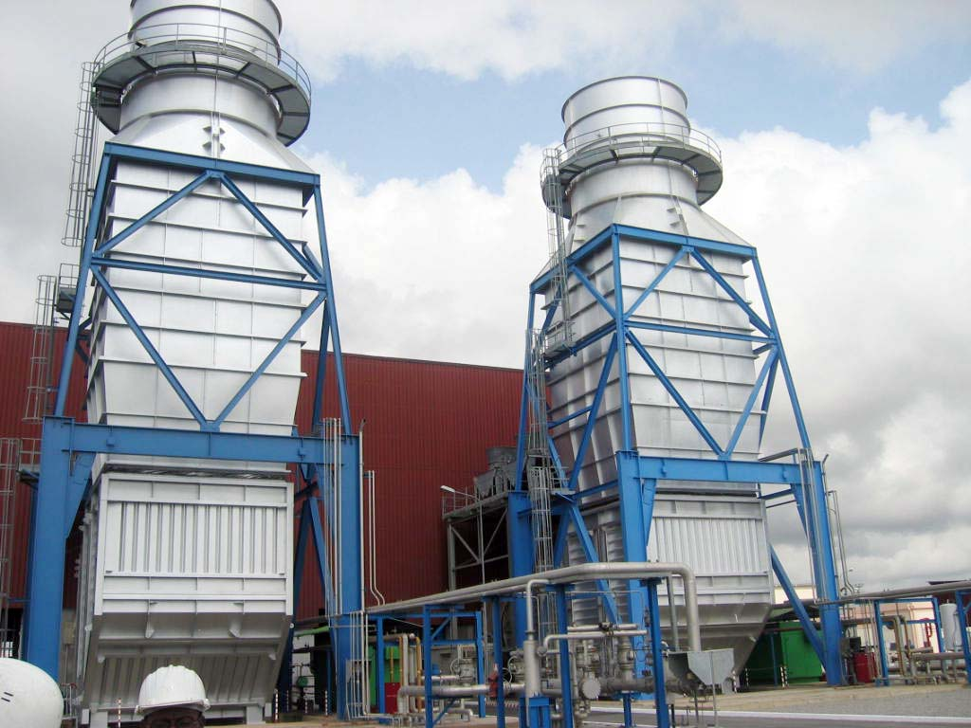
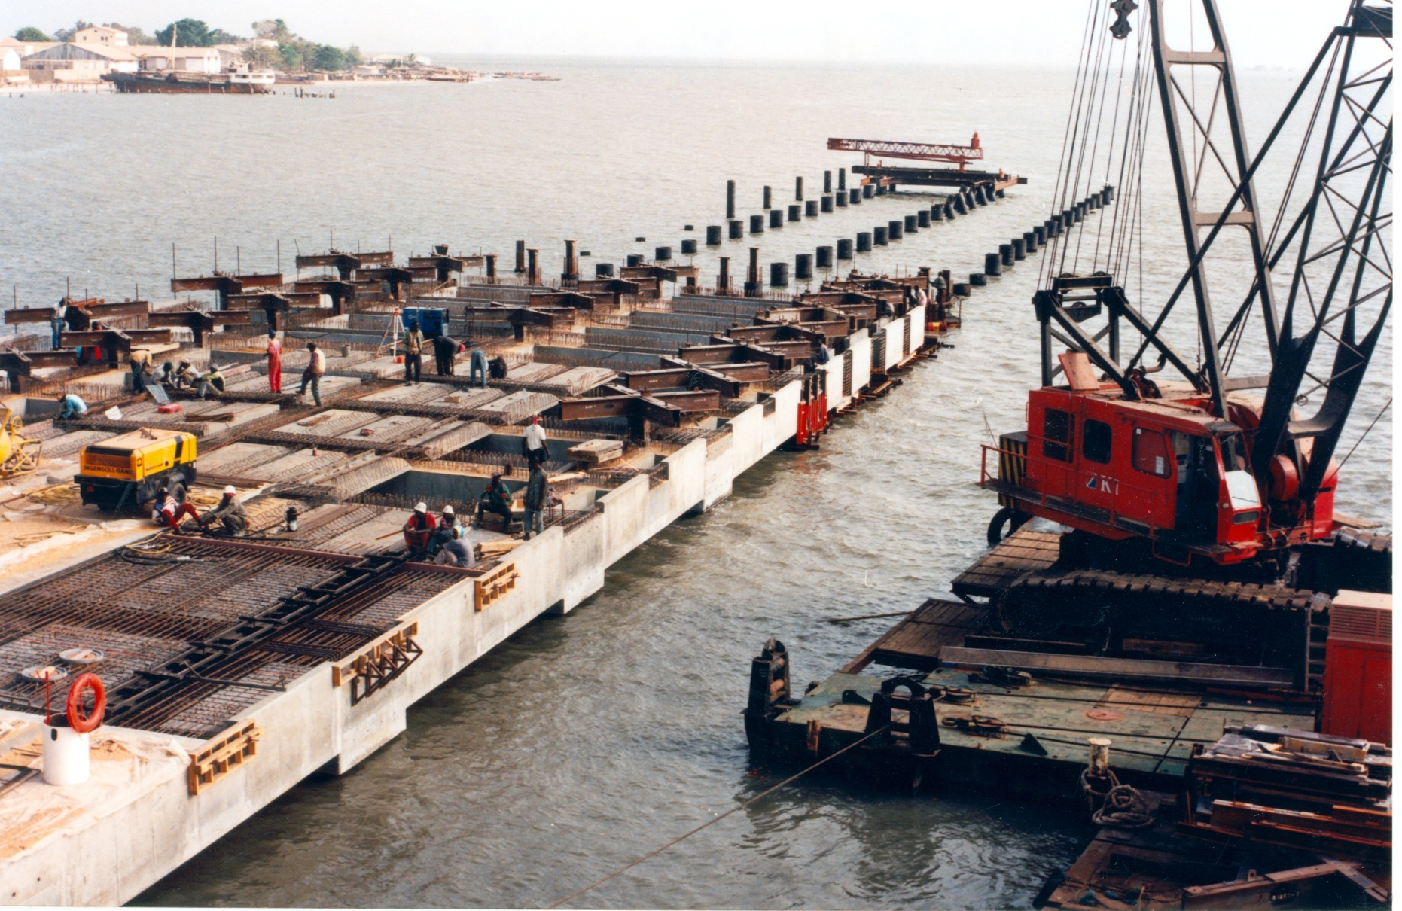
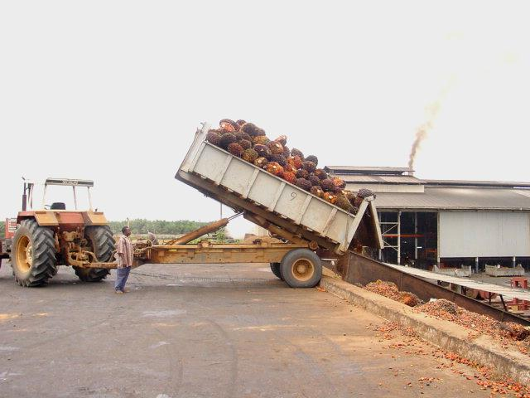

African Development Bank Group
Introduction to the Bank’s Private Sector Operations
Africa: The Next Frontier
How can the AfDB help investors?

Slide 2
The AfDB has two lending windows:
Sovereign Guaranteed Operations (public sector projects through governments at concessionary terms)
Non sovereign Guaranteed Operations - OPSM (private sector projects at commercial terms)
The AfDB Private Sector’s activities comprise two categories:
Non-sovereign guaranteed lending activities in the area of Financial Intermediation, Industries & Services, PPPs & Infrastructure, Microfinance;
Non-lending activities including studies, initiatives & new programs.

Slide 3
Areas of Intervention
Infrastructure
Focus on Power, Renewable Energy, ICT, Transport, Water
  Encourage PPP operations
  Develop SME linkages
Industries & Services
  Manufacturing (e.g cement), mining, O&G, agro-industries, hospitality, health
  Mostly medium, large and mega enterprises/project finance
  Develop SME linkages
Financial Intermediation
  Banks, DFIs, MFIs, housing finance, leasing, insurance, trade facilitation
  Medium, small and micro enterprises, capital markets

Slide 4

Eligibility criteria
. Client Company must be located and incorporated in a Regional Member Country (Africa), whether promoted by African or non-African investors.
Majority of equity must be privately held (an Enterprise majority owned by the government may also be eligible for Bank assistance, provided that it satisfies the criteria of financial viability, operational and managerial autonomy, and it is run on a commercial basis).
Equity contribution must be at least 30% of total project cost.
Total project cost : minimum of USD 20 million
Maximum AfDB participation cannot exceed 30% of total project cost for Greenfield projects - can be higher for projects entailing expansion of existing facilities.
Evidence of strong integrity, good reputation and adequate financial standing.

Slide 5
Application procedure
To enable the Bank to promptly assess the eligibility of a project for investment, interested enterprises should submit a feasibility study, including the following information :
Description of the project;
Information on the sponsors track-record, including financial and managerial background;
Cost estimates, including foreign exchange requirements;
Financing plan, indicating the amount of AfDB financing desired;
Market prospect, including proposed marketing arrangements; and
implementation plan, including the status of government approvals (if any).
After this information is assessed, the Bank will convey its preliminary views to the applicant. It may ask for additional details and documents for further processing. The Bank will observe confidentiality in its dealing with project sponsors

